Slide 1


Shareholder Services Association
Road Map – Initial Site Build
V6 (2/10/15)
JMarc Technologies, LLC
10 Hillside Avenue
Madison, NJ 07940
Office: (973) 236-1546

Slide 2
Road Map Status
Latest road map (V6.1) delivered 2/11/15 for final review and approvals.
NOTE: Items are not all set in stone so, for example, the site map structure can (and probably will) change as the development site matures and we continue to receive feedback from the SSA.
CHANGES FROM V5:
Forum digest & rights (slide 9) is new
Site Map (slide 11) greatly modified from many discussions (and still needs review/discussion)
Site Template Responsive Design (slide 13) now has screenshots of a developmental version of a page to showcase “responsive” design
Template: Forum (slide 17) now has a mockup (actually a screenshot of early developer version)
Template: Calendar (slide 20) now has a mockup/screenshot
CHANGES FROM V6:
Website Technology (slide 6) - removed LinkedIn (that Drupal component failed JMarc quality testing)
Site Map (slide 11) main menus might be shorter – noted in slide
User fields (slide 22) added note on phone asking if it should be required for members

Slide 3
Timeline
Month 1: 1/8/2015 - 2/11/2015
1/22/2015 - JMarc to provide road map with screenshots and draft site to Website Committee. Jackie will submit to Marketing Committee. Test site will also be available.
1/22/2015 - 2/10/2015 - Ongoing feedback* and development on road map. 2/11/2015 - SSA to provide final approval on road map and design.
Month 2: 2/12/2015 - 3/16/2015
SSA to test all aspects of the site providing continual feedback*. JMarc will adjust the site accordingly. Weekly meetings between the Website Committee members and other testers, with JMarc should occur during this period of time. Harrington to schedule in advance.
JMarc to train Harrington how to load content and maintain system.
Month 3: 3/17/2015 - 4/20/2015
3/17/2015 - 4/3/2015 - Harrington to load content. JMarc will continue to refine, as needed.
4/1/2015 - Jackie to work with JMarc to set up a sample board meeting in development for training purposes.
Week of 4/6/2015 - JMarc and Website Committee to train rest of Board via a Go to Meeting Session. Jackie to ask Pat to deem this session a board meeting, with required attendance. Harrington to schedule in advance, along with a make up session, if needed.
4/20/2015 - Site live for all members / users.
* All feedback from the SSA and responses from JMarc should be sent to info@shareholderservices.org with a cc to Karen Wesloh, with a subject of SSA Website Road Map Feedback. Harrington will track all feedback and responses.

Slide 4
SSA Road Map Objective
This JMarc Technologies, LLC (“JMarc”) Road Map document envisions the new Shareholder Services Association (“SSA”) website. Every feature of the site and the site design elements are detailed for approvals.
This site map is the result of study of the current SSA website, the SSA RFP, JMarc’s knowledge of the SSA, and subsequent meetings and discussions.
The site will be constructed to match this Road Map. The mockups presented in this Road Map may have small visual changes from the Road Map if the technology has specific limitations in envisioning the artistic mockups provided.

Slide 5
JMarc Solution Development Process
JMarc gathers preliminary information about your objectives, needs, desired results, and more enables us to analyze your project to provide the right direction.
Discovery
JMarc will facilitate a set of meetings that takes all of the ideas from the discovery phase and creates a full mockup, or Road Map of the end solution. The Road Map includes mockup versions of every screen and report of the application and all associated rules and needs.
Road Map
Rapid Prototyping
JMarc utilizes a rapid prototyping model where multiple, iterative releases are provided for testing and review. This process allows for additional input and adjustments to be made as the solution is built, resulting in a more powerful finished application.
Full Support
JMarc deploys and supports our custom solutions. This includes: hosting, maintenance, enhancements, and ongoing support.

Slide 6
Website Technology
JMarc will construct the new SSA website using the JMarc Managed Drupal Hosting solution. This list of technology features is intended to provide the framework, but all subsequent pages will be mapped and customized to these technologies:
Amazon Cloud Hosting (Linux, PHP and MySQL)
Drupal 7
Various JMarc supported Drupal modules including Ubercart
Integration with Authorize.Net/TSYS
Google apps (system mail accounts) connected to Drupal via IMAP
Export email lists to integrate with Constant Contact
Google Analytics will be installed and configured to provide usage statistics

Slide 7
Page Types
The SSA website will host several different types of pages. Each will have a template and object model setup in Drupal:
Home Page. A dynamic page that includes many elements of the site, pulled up to a summary view.
Content Page. Articles, news, and other information pages.
Calendar. Online calendar of events in a list and by month.
Forum Topic and Replies. Discussion threads for both public and member’s only use.
Product Page. For eCommerce sales of all items – SSA memberships, eLearning courses, event registrations.

Slide 8
Discussion Forums
The SSA website will host several discussion forums that are limited to active members. These forums will have topics and (optionally) allow discussion on those topics. In addition, attachments can be included to form a library of resources.
When non-members attempt to access a member’s only forum topic, they will be sent to an enticement page to encourage signing up. Thus forum topics can be promoted on the home page (or other pages) and help to drive memberships.
Member-only Discussion forums to be setup:
General Forum. A private members-only general discussion forum. Hot Topics and Q&A items to be posted here.
Abandoned Property Forum.
Cybersecurity Forum.
Resources. A private members-only educational and resource library discussion forum.
Board Forum. A private, board-member only discussion forum.
Additional forums can be added as needed if these become unwieldy. But, until then, it is better to have less forums and higher traffic.

Slide 9
Forum Digest & Rights
EMAIL FORUM DIGEST
The SSA website will have a “forum subscription” system allowing members to choose specific forums to follow and receive a daily digest of updates made on that forum. This approach allows members to follow the site without having to login. In addition, the digest approach helps to reduce email flow by sending one email with summaries of all posts.
FORUM RIGHTS
It was brought up that specific rights to forums must be well planned and communicated – so when a member makes a post they understand (or can restrict) who sees that post (possibly restricted by “member type” not just all members?). This will need to be fleshed out during the development cycle with SSA input.
Also, members who make a post can later edit that post. Post can be set to auto-expire if desired. Posts will also clearly present the date and time they were made so readers can self-evaluate their relevance.

Slide 10
Current site pages mapped to page types
The current website pages are below, organized by page type – to ensure that current content is accounted for in the templates that will be created. Note that other new site features will be new for the SSA website.
    Home page -> home page
    Online Membership Application (form & PDF) -> Custom form/eCommerce item & PDF
    Calendar -> calendar
    eLearning -> eCommerce items and supporting files
    Member’s spotlight -> User/Spotlight
    Welcome new members -> block listing members reverse date
    (Member only) Hot Topics, Q&A, Resources -> Member only Discussion Forums
(page below) -> Content Page
    Mission, President’s Letter, History, Industry Connections, Membership Profile, Officers & Directors, Board Committees, Past Presidents, Bylaws, James R. Smith Scholarship Program, Tony Fireman Award (and supporting pages), Benefits of Membership, 2015 Annual Conference, 2014 Annual Conference [+ photo album], 2014 ICB Credits, 2014 Conference Sponsors, 2013 Conference (and subpages), Attendee Comments, Hotel Accommodations (2015).

Slide 11
Site Map
Bold items are the main menu tabs (in the white bar in the header). Contact Us will be in the footer.
News and Hot Topics (or “News”)
Home Page
Hot Topics, SSA Position Articles
Education and Resources (or “Resources”)
Training Courses
General Forum, Abandoned Property Forum, Cybersecurity Forum, Resources, Board Forum
Events
2015 Annual Conference, 2014 Annual Conference [+ photo album], 2014 ICB Credits, 2014 Conference Sponsors, Attendee Comments, Hotel Accommodations (2015)
Calendar, Event Recaps
About Us
Mission, President’s Letter, History, Industry Connections, Membership Profile, Welcome New Members, SSA Leadership (Officers & Directors, Board Committees, Past Presidents, Bylaws), James R. Smith Scholarship Program, Tony Fireman Award
Contact Us
Join SSA
Benefits of Membership, Online Membership Application, Membership Application PDF

Slide 12
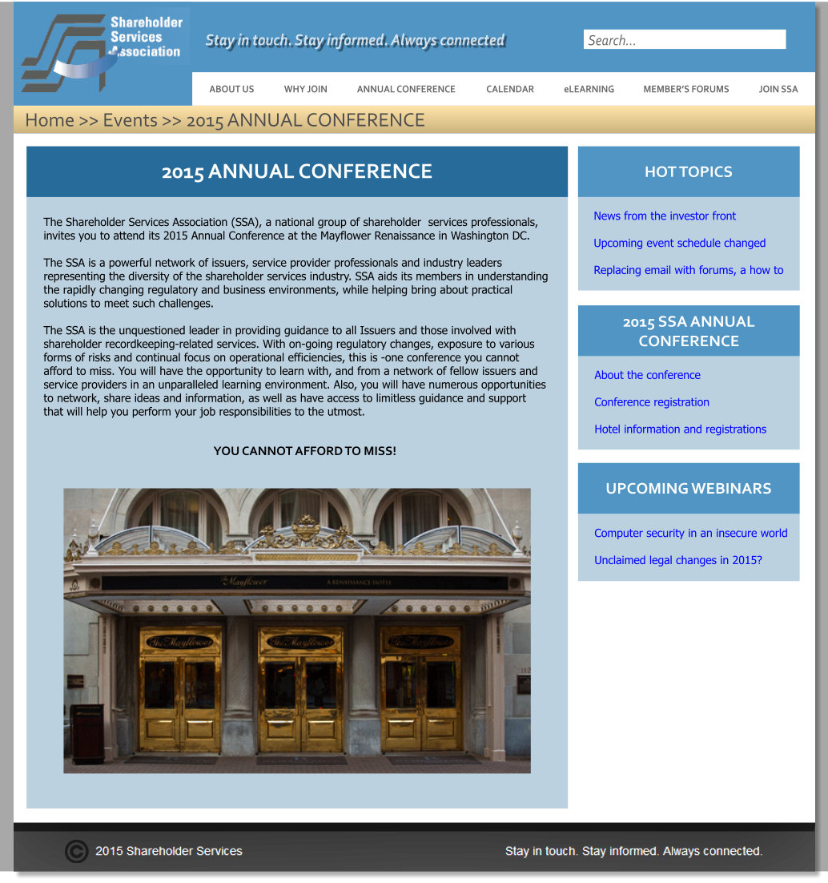
Site Template Design Elements
Simplicity and Readability
Keep the site easy to navigate and read on all platforms.
Never Hidden Navigation
Header, logo, tag line, search, breadcrumb, and main menus are always visible on the screen (they do not scroll)
Support for large and small screens
In addition to the 1001 width, a higher 1343 width designed to support larger screens. The “responsive” design also scales down to smartphone size.
Title and Content Area
Each page content is managed in the Drupal CMS as an object. Can include HTML/graphics as needed.
Right side breakouts
“Blocks” highlight other sections or content on the site. Each block can be assigned to specific pages to allow more relevant site suggestions.
Fixed box
Based on feedback on the project so far, a boxed look is to be used so the content doesn’t just flow full left to right on very large screens.

Slide 13
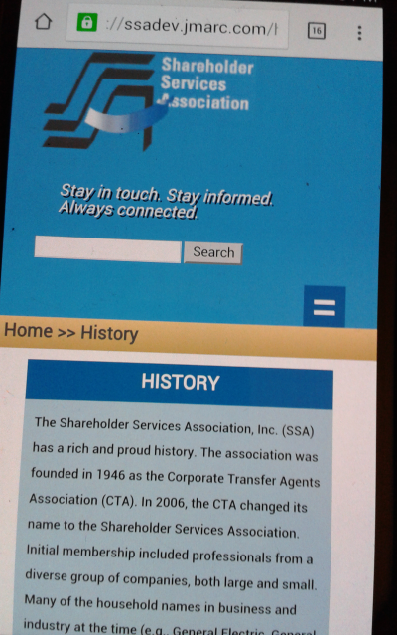
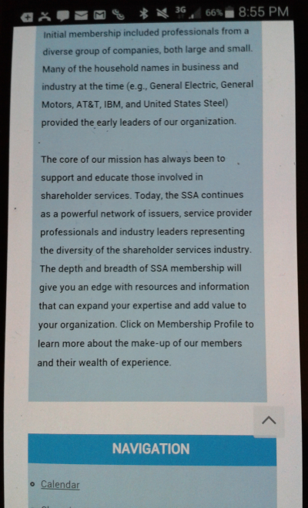
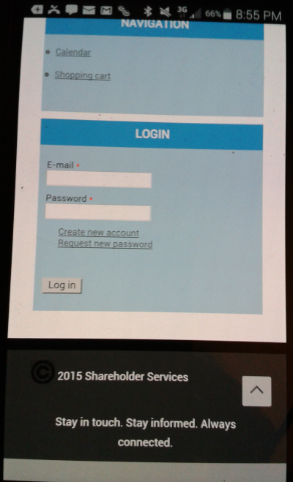
Site Template Design - Responsive
Here are actual screenshots of the developmental version of the SSA website to demonstrate the “responsive” design. See how the content page (in this case, the history page) reformats to the phone format by putting the blocks at the bottom, changing the top menu to a pop up instead of tabs, and showing the content itself in a way easier to read on the thin screen. These pics are showing the same page as you scroll down to read it:

Slide 14
Right Side Breakouts (“blocks”)
Several different types of content “blocks” will be created and utilized as part of a right side breakouts area on various pages. Each block can be assigned to specific content pages and/or the home page.
Hot SSA Topics. Selected forum topics from the new SSA private forums.
Recent SSA Topics. List of the most recent general forum topics.
Recent Unclaimed Property Topics. List of the most recent unclaimed property forum topics.
SSA Member Badge. When posting articles or forum topics, a visible block with the member’s name, photo, and other information. Some information is visually restricted to SSA member’s (contact information, etc.) while others will remain publically visible (photo, name, company name).
eLearning Course. Each course can have a block so it can be highlighted on selected pages.
SSA Event. Each event can have a block as well.
SSA Member Spotlight. A block to highlight the currently spotlighted member and link to that spotlight page.
Videos. Training or webinar videos put in a block and usable on different pages.

Slide 15
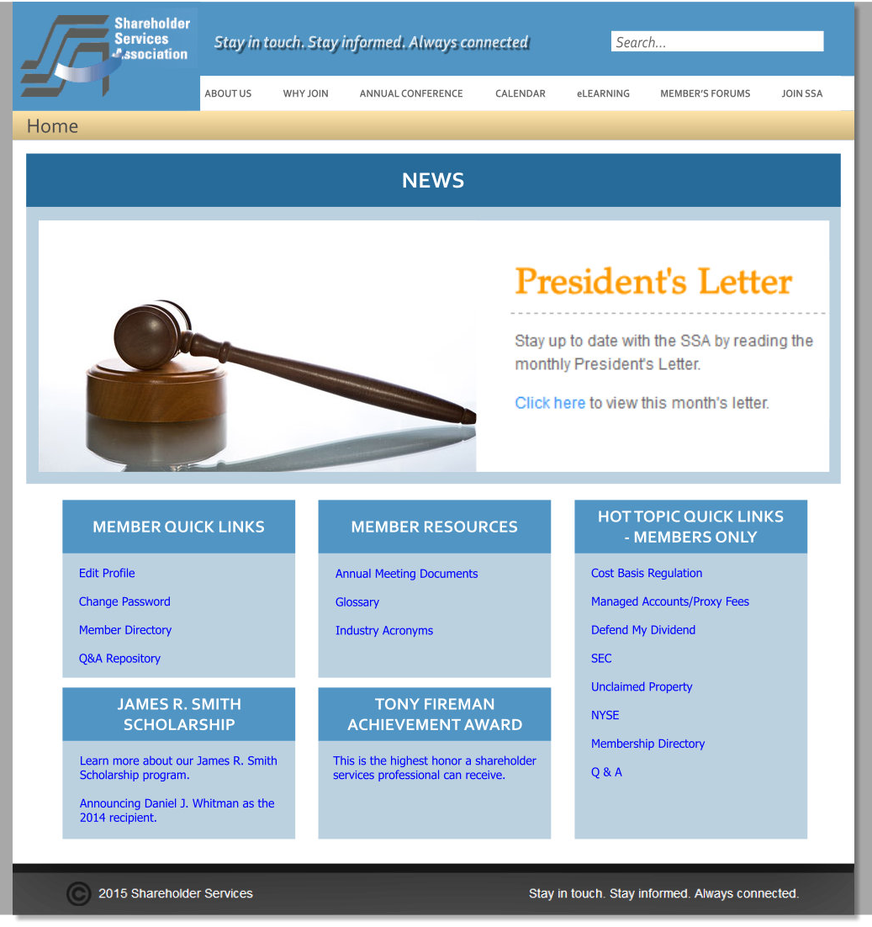
Template: Home Page
Rotating News Banner
Large, but not full-screen or super tall, area that rotates news items with graphics, text and a link.
Same Header
Site look will remain 100% consistent from page to page – instead of a “splash page” model where the home page doesn’t have the same navigation.
NOTE: the trend is to go with
absolutely massive images on
the home page – JMarc doesn’t
recommend that approach for
the SSA – instead present a
cleaner, more functional look.
Selected Blocks
Blocks can be selected to appear on the home page for any of the site content items, lists, etc.

Slide 16
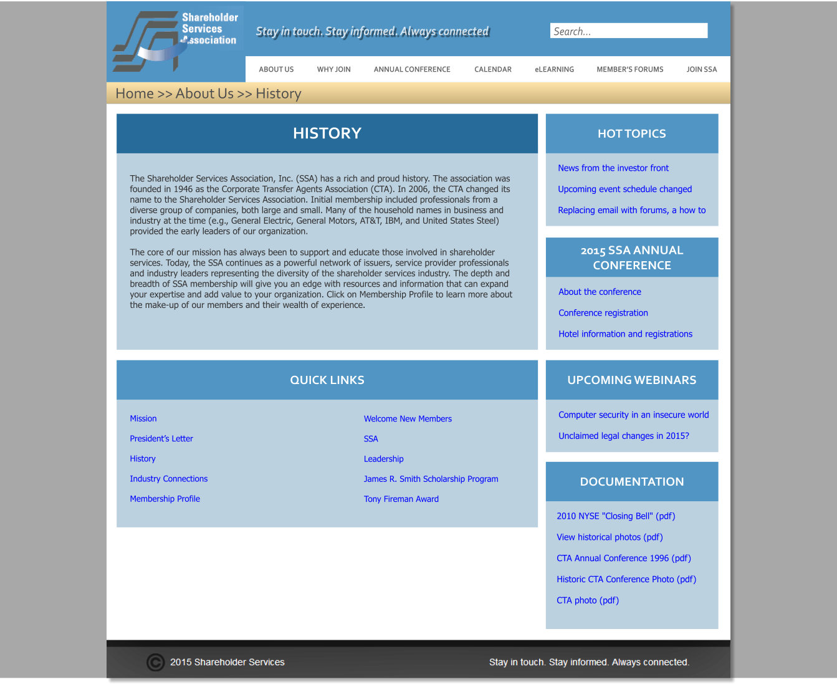
Template: Content Page

Slide 17
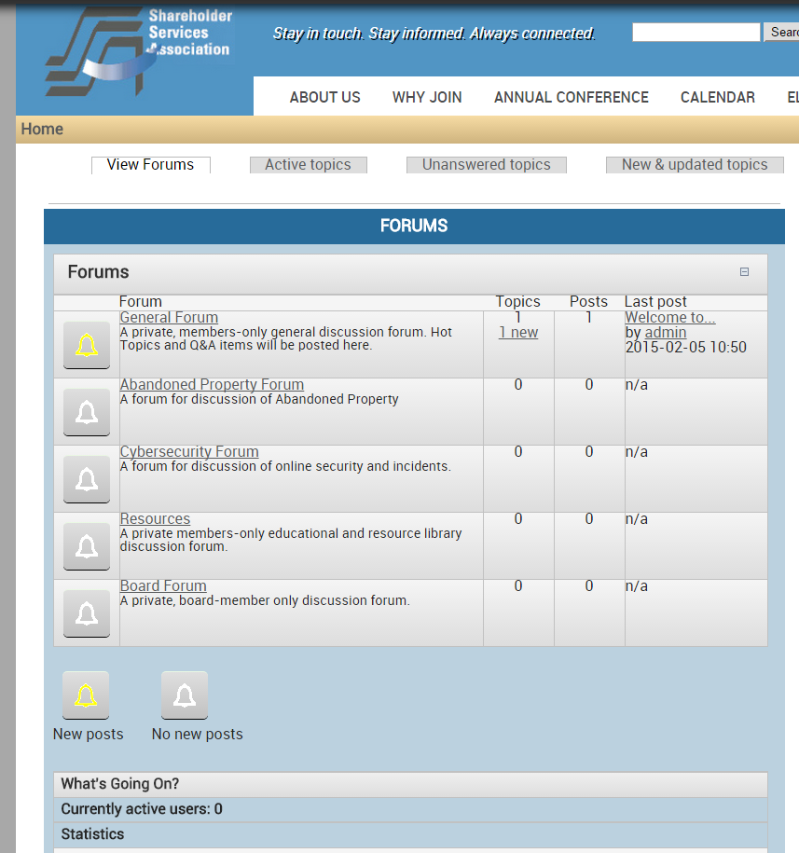
Template: Forum Topic & Replies
This is a very early developmental screenshot (not a mockup) and it will receive considerable visual tweaks as the sight is built.
The forum system will offer multiple forums, each with their own topic threads and ability to read/reply for members only.
Anonymous users will not be able to see posts in a forum – we can decide later if they see the list of forums or not as tease.

Slide 18
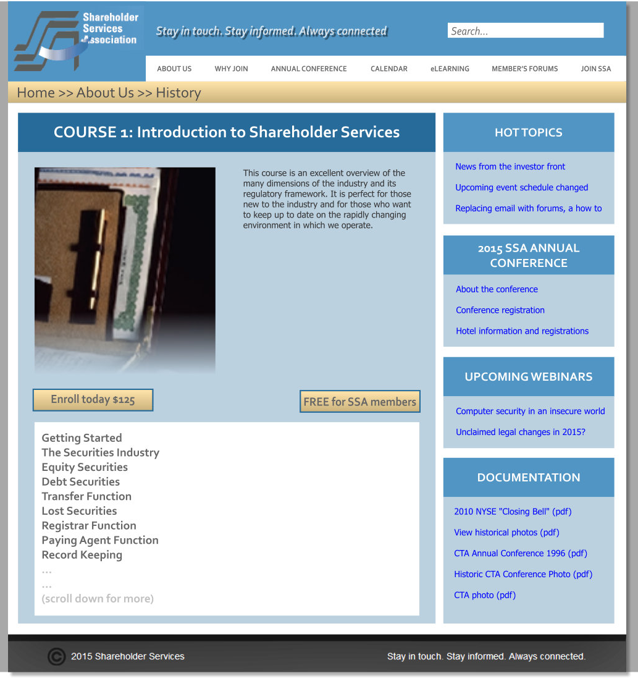
Template: eLearning (to purchase)
eLearning as eCommerce items
Each course can be individually purchased, or accessible for active members for free.

Slide 19
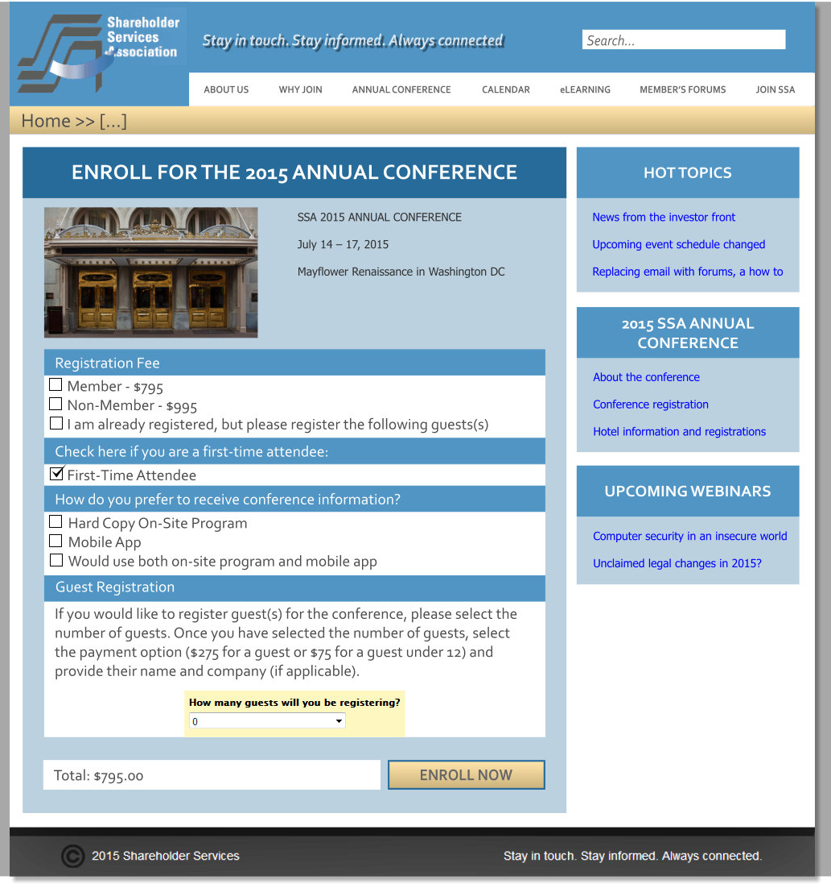
Template: Event (to purchase)
Note: all mockups, but especially this one, my look different when implemented.
NOTE: add disclosure about photos being taken and posted later.

Slide 20
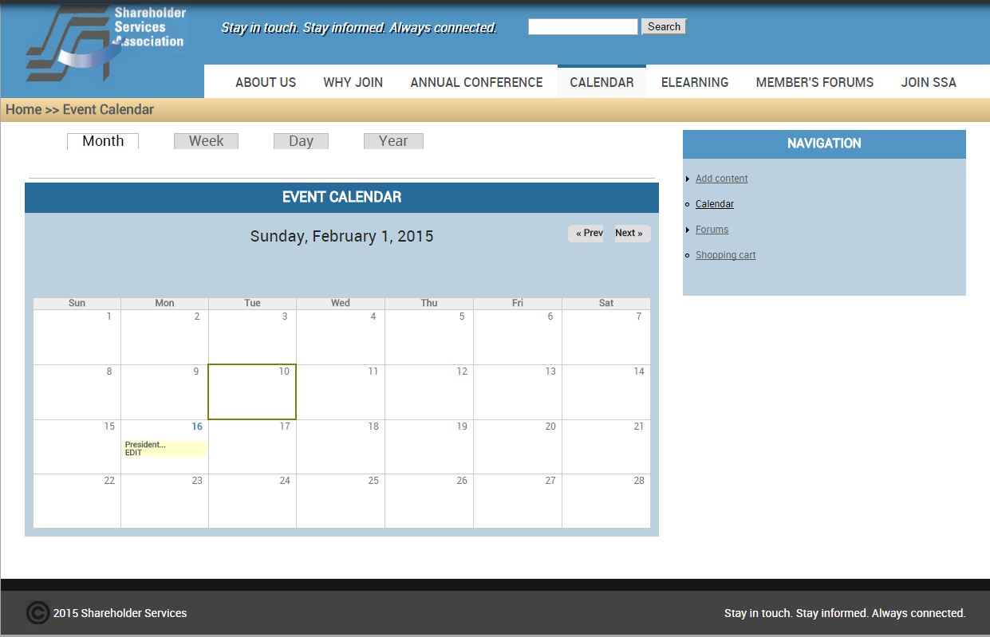
Template: Calendar
This is an early developmental site screenshot (not a mockup). The calendar system look will be tweaked as the site is built and the breakouts on the right side will mature as well. The calendar system will offer a schedule of events and then a way to get more information for each event and then purchase or sign up via the eCommerce system.

Slide 21
Account types
Anonymous User
Users can visit the site and review specific, public pages such as the home page, some content pages, and more.
Free login account
Users can sign up for a free login account to the SSA website that can then allow for more content to open up (to be defined by the SSA). In addition, this free account is required before any purchases or memberships can be made. Also, if a membership expires, the user will revert to a free account automatically.
NOTE: Add an upsell push here (pop up?) to encourage membership.
Active membership
Users who purchase a membership (or are configured by administrators) will gain more site access including the private member forums and eLearning courses.
NOTE: For the free account, a set of fields will allow collection of some information. When purchasing a membership, an additional set of fields will be shown. Some fields will be required on these (next slide). One point of caution: in JMarc’s experience, less is more – there is a barrier of entry problem when asking anonymous users to create an account.

Slide 22
Login process and required user fields
For direct login accounts, we will require a minimum of 8 characters length, at least 1 capital letter, at least 1 number. The login process will require a working email account for the user to verify their account.
In addition, these fields will be presented (* = required for free; ** = required for member):
First name*
Middle initial
Last name*
Suffix
Designation (ex. CPA or PhD)
Informal name
Title
Company
Email address*
Work phone (require for members?)
Home phone
Cell phone
FAX
Website
NOTE: More user fields/tabs are defined in slide 27
TBD: Karen Wesloh to map out current strategy and review with team.
NOTE: Users will be using their email as the login id
ADDRESS:
Address**
Address 2
City**
State/Province**
Zip/Postal Code**
Country
ALTERNATE ADDRESS
(same fields)
THIRD ADDRESS
(same fields)
BUSINESS:
Service Prov Business Sector
Issuer Business Sector
Incorporation
Exchange
Ticker Symbol
Transfer Agent Type
Agent Name
Issuer Reporting Structure
Recent Experience**
In-House Software
Years in SSA
How did you hear about SSA?
Years Attended Conference
Areas of Interest**

Slide 23
eCommerce process
The SSA website will provide users the ability to sign up for a free account and then add items to their cart. Once they go to purchase, the site will utilize the Authorize.net payment gateway to process the transaction. Credit card numbers will not be stored on the SSA website. The entire payment process will be secured using encryption (SSL).

Slide 24
PCI compliance
PC checklist and the SSA website’s compliance tactic. Reference http://drupalpcicompliance.org/files/DrupalPCICompliance.pdf for more detail on the PCI rules and Drupal’s core compliance. The summary is that the SSA website will be PCI compliant utilizing JMarc’s services as well as by not storing credit card information and utilizing Authorize.net for that aspect of the process.
Install and Maintain a firewall
JMarc’s service has a firewall.
Do Not Use Vendor Supplied Default Passwords
All accounts will be forced to change password when first used.
Protect Stored Data
Credit card data will not be stored on the JMarc servers, but rather on Authorize.net/TSYS
Encrypt transmission of cardholder data across open, public networks
eCommerce process will be under encryption (SSL)
Use and regularly update anti-virus software or programs
JMarc uses and updates anti-virus software on all systems and servers
Develop and maintain secure systems and applications
JMarc’s service is continuously maintained

Slide 25
PCI compliance (continued)
Restrict access to cardholder data by business need-to-know
Credit card data will not be stored on the JMarc servers, but rather on Authorize.net/TSYS
Assign a unique ID to each person with computer access
Every user gets a unique account to utilize during the eCommerce process
Restrict physical access to cardholder data
Card information is stored on Authorize.net/TSYS
Track and monitor all access to network resources and cardholder data
Card information is stored on Authorize.net/TSYS
Regularly test security systems and processes
JMarc’s service includes maintenance and testing
Maintain a policy that addresses information security for all personnel
JMarc’s service includes maintenance and testing
TBD: Harrington to review JMarc’s responses above and assess PCI compliance.

Slide 26
PII compliance
Reference site: http://www.gsa.gov/portal/content/104256
This analysis will need to wait for completion of the fields the SSA will collect for each user. In general, name, email and address are considered public information, so we don’t envision a problem with PII compliance.

Slide 27
Membership information (tied to “User”)
The user system will be customized to include more information about users. This information will be displayed to member’s only (unless identified as a public field below).
All of the fields will be present from slide 18 (required user fields), so below is that plus:
Title (public)
Member since (public) *Note will need to manually edit existing members to set their start date
Is a current SSA member *Note: tied to the eCommerce process with auto-expiry if not repurchased
Spotlight (public) *Note: a full tab with the member spotlight article if there was one done for the member
Recent SSA forum posts

Slide 28
Membership “badge” & Member’s List
Each SSA website user will have a nice looking badge when making posts in the forum with their name, photo and link for more information.
This same badge will appear on other content pages of the site as desired (as an author of the content, or a person referenced by the content).
A member list page will be created that shows the list of current members with some selected information (and photo) with a link to the user page that has more information. This page will be restricted to current members only.
NOTE: Need to work on the process for the user photo – do we want users to upload/manage it directly? Do we want to have Harrington manage it? Note JMarc has tested and will not be using the LinkedIn module for Drupal due to very serious bugs – so we cannot auto-pull from LinkedIn.

Slide 29
Member Spotlight (tied to “User”)
A user-based tab called “Spotlight” will be added and can be populated for all current/prior spotlighted members. Date spotlighted to be added, then a large HTML block with the article. Spotlight will be public for all users to see.
Users who have Spotlights will appear in a sidebar block “Member Spotlights” sorted by date spotlighted (descending).
This approach ties the spotlight to the user record on SSA and thus be tied to their SSA “badge” blocks and well integrated into the flow of the site when reviewing users.

Slide 30
Service provider directory
Service providers will each have their own content page, with a right sidebar of a list of all service providers. Their area is full HTML allowing for good looking pages. The right side sidebar will auto-update as new providers are added (or ones are removed).
In addition, each service provider can opt to link to SSA member profiles from this page so that faces can be shown of SSA members for that provider with links for more information.

Slide 31
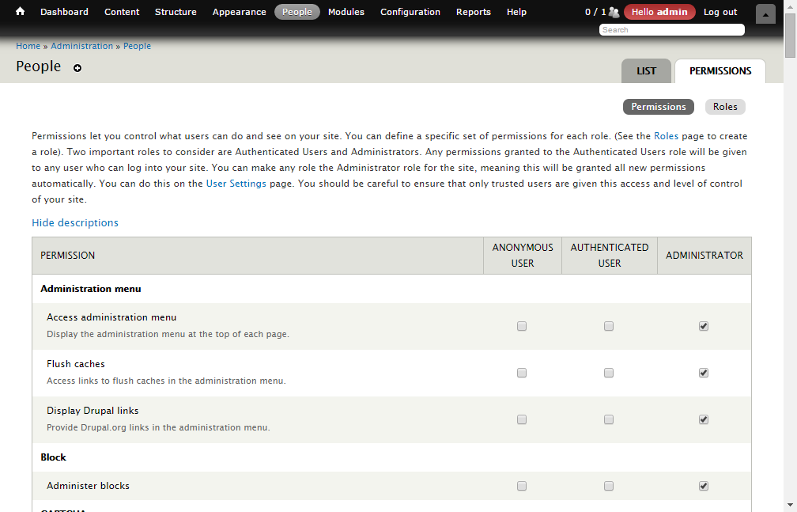
Site Roles
The website will have multiple roles created that allow different levels of rights:
Anonymous user
Authenticated user
(not active member)
Active member
Board member
Administrator
JMarc’s solution allows creation of any number
of roles which can have very granular rights.

Slide 32
Managing site changes
There will be both a development and a production site for the SSA to use. This allows many different approaches to content changes.
Structural/large changes/code changes – dev.shareholderservices.org
Any significant site changes, code changes, or even updated content can be made on the development site for preview by authorized users.
Standard content update process – private review forums
Multiple forums will be setup on production, and forums specifically for content review will be created. Using the Drupal editor, it is trivial to copy approved content to the final publishing location. This approach also allows a full commentary thread to exist in one location, minimizing email Ping-Pong and keeping a master version of the latest update available for review at all times.
Timed content release
An option for any content to be posted is to set the publishing date (and even an expiry date) to allow work to be done early and ready for publication.

Slide 33
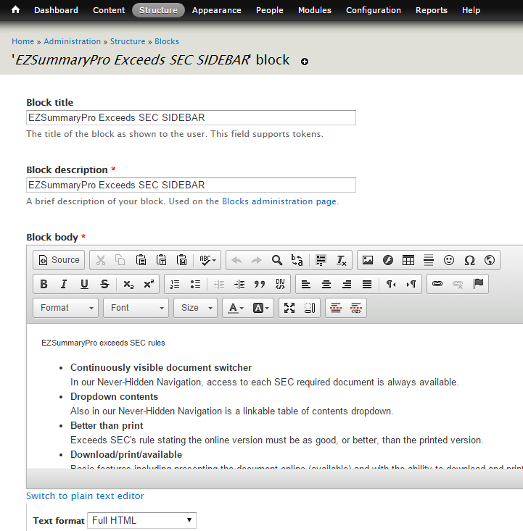
Editing content
Authorized users / administrators will be able to edit the site using a WYSIWYG editor.
Site pages as well as “blocks” are editable using the same tools and for advanced needs, it allows switching to a full HTML mode for any sort of necessary tweak.
Other robust administrative functions are available and JMarc will train Harrington on all aspects to administering content.
An example of editing a “block” on a JMarc site.

Slide 34
Administrator training topics
Training part 1: Basic content and user administration
Finding existing content and editing
Creating a new page (title, body wysiwyg and source, menu settings, URL path, publishing options)
How to add/change images on a content page
Creating a new block (title/description, body wysiwyg/source, the div wrapper, region settings, show blocks on specific pages)
Content “Revisions” system
Finding, editing and administering user accounts
Training part 2: Advanced topics
Adding/editing eCommerce items
Managing the calendar system
Administrating forums
Adding photo albums to content areas
Pulling email lists, reporting eCommerce sales, other site reports
For these organized training sessions, we recommend (and can implement) recording for future training needs. But, in addition to the formal sessions, JMarc will continue training as needed for Harrington.

Slide 35
Backup and Disaster Recovery
The production SSA website will exist on JMarc’s Amazon Cloud infrastructure. Backups will be handled as follows:
All backups will be managed at a different physical location and can be used in a disaster scenario to rebuild the site.
The site will be snapshot every day and backed up (full site).
Additionally, on the server itself the database has an additional backup done daily (and a weekly and a monthly) which can be used for restorations as needed before resorting to the file backups.
This strategy results in a maximum exposure of 24 hours of data loss in a catastrophic event such as the complete destruction of the Amazon data center. NOTE: backups of the credit card processing will need to be managed by Authorize.net/TSYS as the SSA website does not store that information.
For non-catastrophic issues, such as a bad content page edit, the internal “Revisions” system can be used to revert to prior good versions – so Harrington can manage that without needing JMarc assistance.

Slide 36
SSA Website FUTURE ITEMS
The JMarc RFP stated that some requested items would need to come in a later phase of the site. These items were identified and not part of the first version of the new site:
Pulling RSS and other vendor information into the site
Drupal is capable of this, but it will require customizations and it was left out of this proposal in order to meet the deadlines.
eLearning training/exam process
Further study will be required to map out moving in the full eLearning experience into Drupal.
Use of Constant Contract will continue
For this project, email communication to members/contacts will continue via Constant Contact.

Slide 37
Contact JMarc Technologies, LLC
For more information, contact:
Rich Andrews
CTO
JMarc Technologies, LLC
10 Hillside Avenue
Madison, NJ 07940
(973) 236-1546
Mobile (304) 804-3963
rich@jmarc.com
John DeFilippis
CEO
JMarc Technologies, LLC
10 Hillside Avenue
Madison, NJ 07940
(973) 236-1546
Mobile (201) 213-9024
john@jmarc.com

